Slide 1











Document Similarity & Applications Quick Intro to Image Analytics & Topic Modeling Analytics for Unstructured Data MSBA, Fall 2023 Session 7, 12th September
Dr. Anitesh Barua
David Bruton Jr. Centennial Chair Professor in Business
Distinguished Fellow, INFORMS Information Systems Society
University of Texas Distinguished Teaching Professor
McCombs School of Business, University of Texas at Austin
Email: anitesh.barua@mccombs.utexas.edu

Slide 2
Document Similarity & Applications (i) Resonance Analysis (ii) Crowdsourced Recommendation Systems

Slide 3
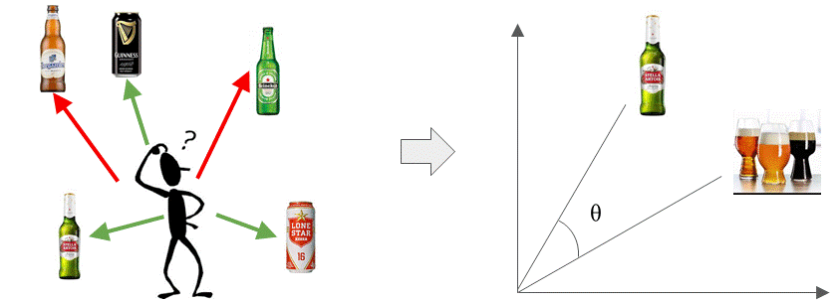
Assessing Document Similarity
Early applications: Document clustering/categorization & retrieval
Many business applications
E.g., which beers or movies are similar?
Useful for recommender systems – both conventional & crowdsourced
Understanding your competition in markets with lots of products
Myriad applications: Did a campaign resonate with the intended audience?
© Anitesh Barua, 2023

Slide 4
The Basic Idea
Start with a numerical representation of each document
Many ways to represent a document with numbers
Presence absence of each term (0/1)
Raw or scaled (normalized) frequency of each term
TF-IDF of each term in a document (be careful, not applicable everywhere)
Multiple ways to calculate similarity between the documents
Choice 1: Calculate Euclidean distances between documents
Choice 2: Calculate the % words that are common across the documents
Choice 3: Calculate the angle between the two document vectors (many variations are possible)
Choice 4: Use word embeddings (e.g., word2vec) and calculate similarity
© Anitesh Barua, 2023

Slide 5
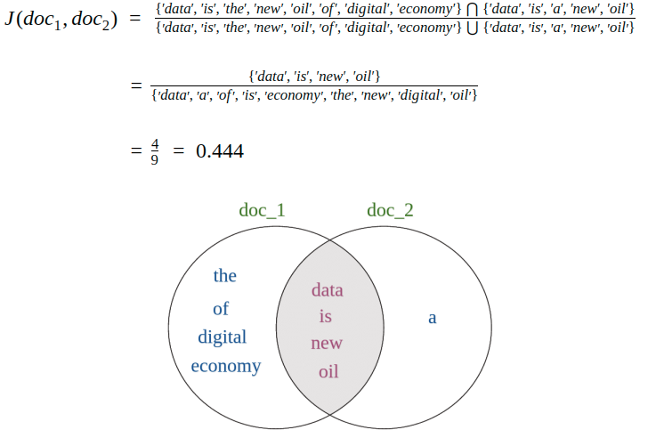
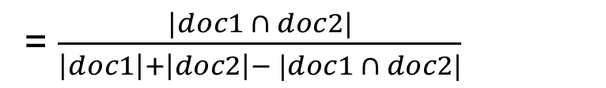

Jaccard Similarity
$$Jaccard\left(doc1, doc2\right)=\frac{|doc1 ∩doc2|}{|doc1 ∪doc2|}$$
= $\frac{|doc1 ∩ doc2|}{\left|doc1\right|+\left|doc2\right|− |doc1 ∩ doc2|}$
Doc1: Data is the new oil of the digital economy
Doc2: Data is a new oil
Source: B. Kanani

Slide 6
Angles Instead of Distances
n-dimensional space with n terms
A document (e.g., tweet) represented
by its coordinates in this term space
t ₂
d ₂
Doc 2
Term 2
d ₁
Doc 1
θ
t ₁
Term 1
t _{n}
Similarity between documents d₁ and d₂ (could also be a set of keywords) is the cosine of the angle Ɵ between them.
Score between 0 and 1.
Source: http://pyevolve.sourceforge.net/wordpress/?p=2497

Slide 7
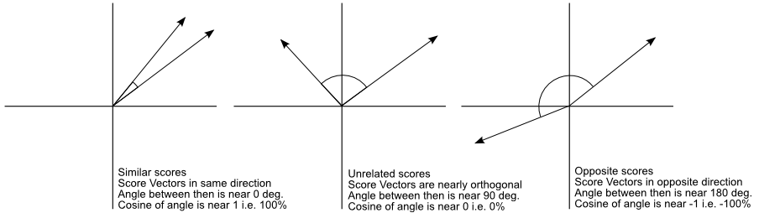
Similar vs. Unrelated Mentions
Ref document
or keywords
Social mention
Is this approach better than Euclidean distances?
Source: http://pyevolve.sourceforge.net/wordpress/?p=2497

Slide 8
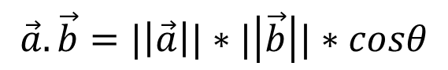
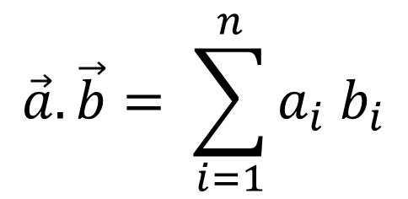
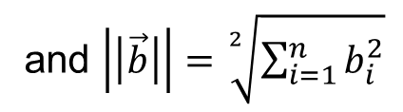
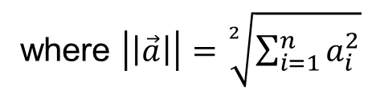
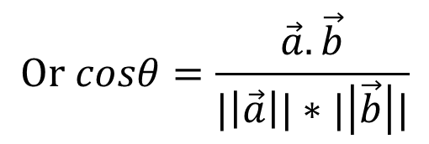
Basics Revisited…
Dot product of two vectors
$$\vec{a}.\vec{b}= \sum_{i=1}^{n}{a_{i} b_{i}}$$
n features, a_{i} and b_{i} can be tf, tf-idf, or other scores depending on application
What does a dot product mean geometrically?
$$\vec{a}.\vec{b}=|\left|\vec{a}\right||∗|\left|\vec{b}\right||∗cosθ$$
where $\left|\left|\vec{a}\right|\right|=\sqrt[2]{\sum_{i=1}^{n}{a_{i}^{2}}}$
and $\left|\left|\vec{b}\right|\right|=\sqrt[2]{\sum_{i=1}^{n}{b_{i}^{2}}}$
$$Or cosθ=\frac{\vec{a}.\vec{b}}{|\left|\vec{a}\right||∗|\left|\vec{b}\right||}$$

Slide 9
In Practical Terms ….
Cosine of angle between two vectors represented by documents d_{j} and d_{k}.
The denominator involves the lengths of the vectors.
What is the key advantage of cosine similarity over Euclidean distance?

Slide 10
Useful for Information Retrieval
Term frequencies
TF | D1 | D2 | D3 | D4
Who | 0 | 0 | 1 | 1
Wrote | 0 | 0 | 0 | 1
Wild | 1 | 1 | 1 | 1
Boys | 1 | 1 | 0 | 0
IDF = log(1/DF)
=log₁₀(1/.5)=.301
.602
0
.301
query = ‘who wrote wild boys’
doc1 (D1) = ‘Duran Duran sang Wild Boys in 1984.’
doc2 (D2) = ‘Boys don’t remain wild forever.’
doc3 (D3) = ‘Who brought wild flowers?’
doc4 (D4) = ‘It was John Krakauer who wrote In to the wild.’
Weights based
on document
frequency
Final TF_IDF weights
TF_IDF | D1 | D2 | D3 | D4 | Q
Who | 0 | 0 | .301 | .301 | .301
Wrote | 0 | 0 | 0 | .602 | .602
Wild | 0 | 0 | 0 | 0 | 0
Boys | .301 | .301 | 0 | 0 | .301
Similarity | D1 | D2 | D3 | D4
Query | .408 | .408 | .408 | .913*
Similarity(Doc1,Query) = (0+0+0+.301^2) / [(.301^2)^.5 * ((.301^2 + .602^2 + .301^2)^.5)]
= .0906 / (.301*.7373) = .408

Slide 11
Application 1: Assessing Relevance and Resonance
How do we know if our campaign/message is having an impact on what people are talking about?
E.g., political campaign
Product or brand campaign
How companies describe themselves vs. how employees feel
A simple approach: How “far” are the social mentions from the message?
© Anitesh Barua, 2023

Slide 12
Application 2: Crowdsourced Recommender Systems
Why bother about recommender systems?
The long tail of products
Matching products with customer preferences

Slide 13

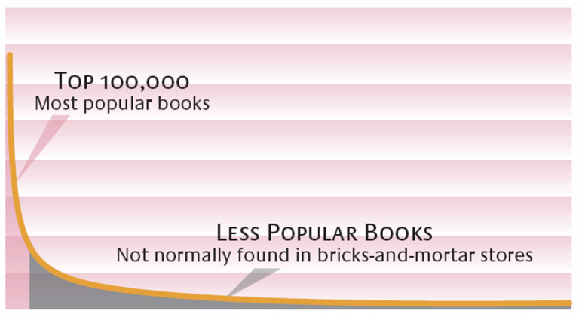
Enabling Forces: The Long Tail*
Sales
High Popularity Low
Customer preferences are diverse
Endless variety of products available
Uncertainty in the tail region
Long tail will not work without recommenders and/or word-of-mouth
© Anitesh Barua, 2023
Source: Brynjolfsson, Hu and Smith; *Chris Anderson

Slide 14
Crowdsourced Recommender Systems
The case of hotel search
Web sites (e.g., hotels.com, orbitz.com, Tripadvisor.com) show by one criterion
Rating
Stars
Location
Price
But most customers consider multiple attributes
How can we provide a better match with customer preferences?

Slide 15
A Lot Better than a Single Criterion
Obtain user inputs, e.g.,
Romantic, ambience, mid-priced, beachfront
Business, budget, wi-fi, convenience
Crowdsource!
Extract large # conversations about hotels
Now becomes a document retrieval problem
E.g., query: Romantic, ambience, mid-price, beachfront
Calculate cosine similarity between query & mentions
Rank mentions by cosine similarity
Perform sentiment analysis to find most positive reviews
Make recommendations

Slide 16
Additional Data
Augment text with:
Vicinity: E.g., Microsoft Virtual Earth Interactive SDK (software development kit)
Proximity: “near a beach”, “near downtown”, “near public transportation” with user geotagging & automatic classification of satellite images of areas near each hotel (e.g., geonames.org)
Additional information become extra dimensions for cosine similarity analysis
Overall results: Superior to those provided by any of the major hotel search sites

Slide 17
Observations on Recommender Systems
Recommendations may be from the tail region (increases product diversity)
If you know of a product, a recommender system can find products
that are more affordable
which people like for the same reasons
Widespread use of recommenders can shift the demand curve
For the long tail idea, see https://medium.datadriveninvestor.com/who-is-your-competitor-in-the-era-of-the-long-tail-d0ac24fedde8
Details of a crowdsourced recommender system: https://towardsdatascience.com/a-recommender-system-based-on-customer-preferences-and-product-reviews-3575992bb61

Slide 18
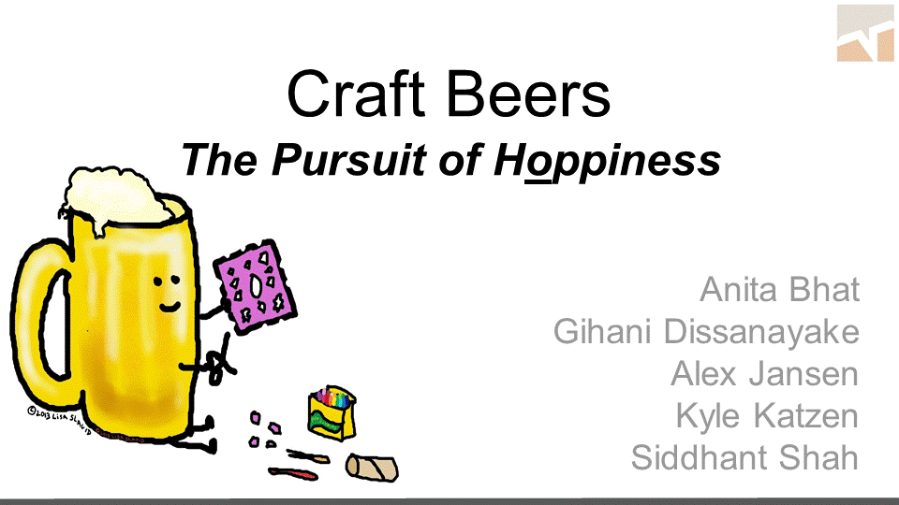
Exemplar Project #1: MSBA Project

Slide 19
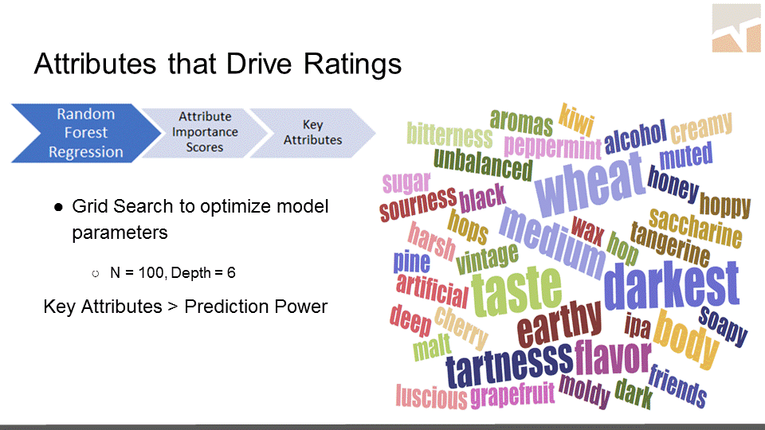

Slide 20
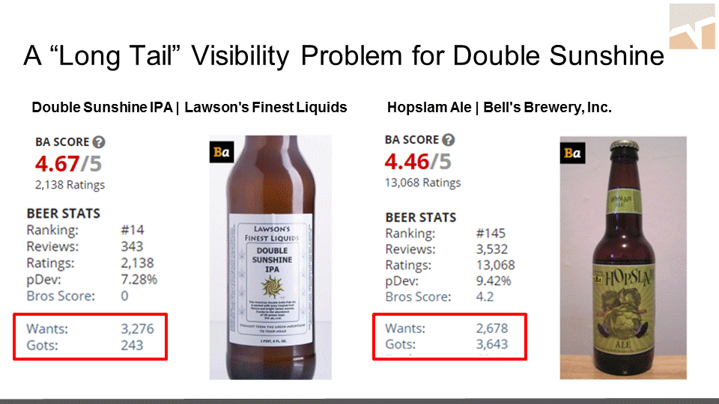

Slide 21
Image Analytics: The Business Case
Images (and videos) contribute much more to big data than text (or numbers)
> 3B images posted per day on social media
> 80% have no text attached
Medical images in healthcare
Can provide additional insights

Slide 22

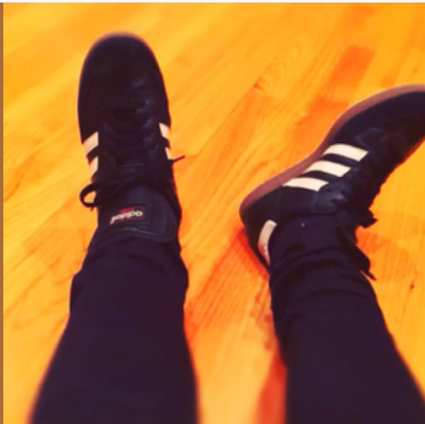

What Does an Image Reveal?
Dubai you will be missed.
Thank you for the inspiration
and the reset. Back to work now. 💙🌺
Post by Skrillex

Slide 23
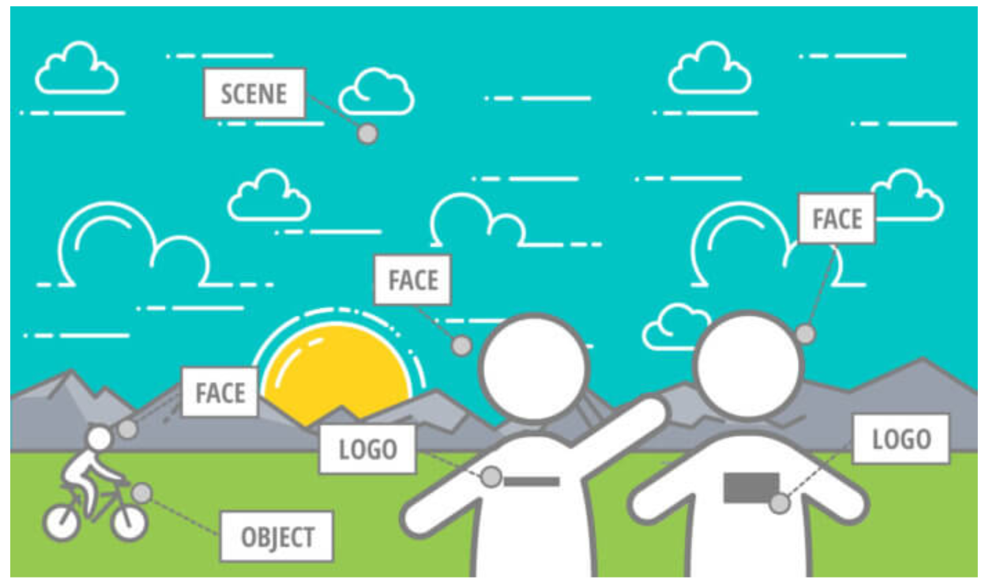
Many Elements

Slide 24
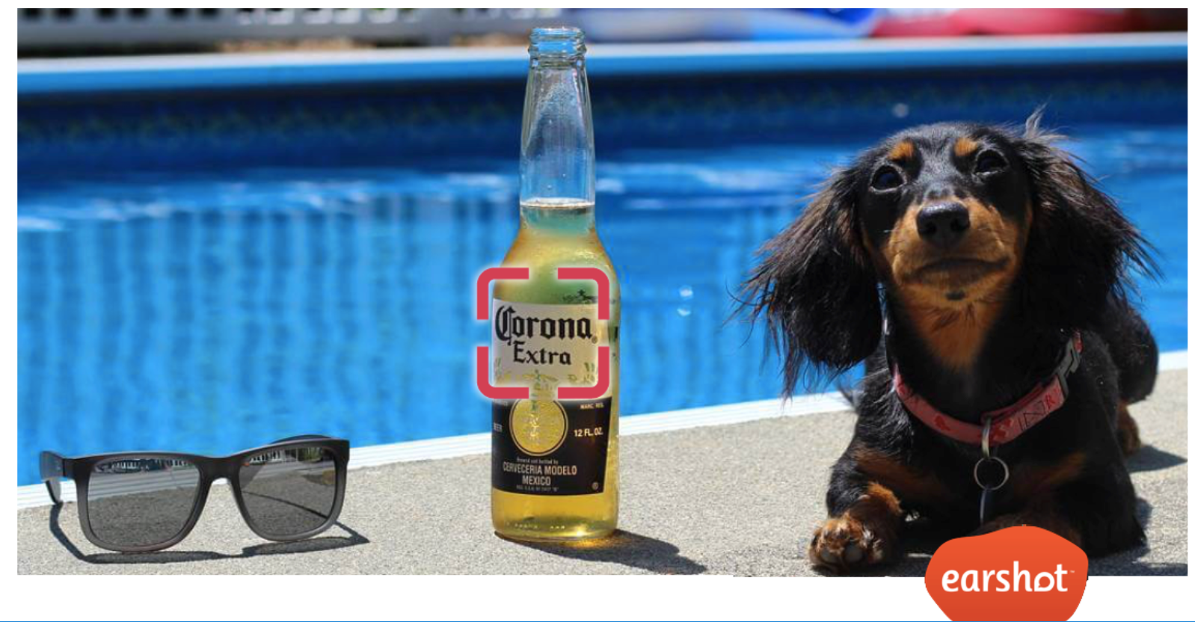
Moments of “Truth”

Slide 25
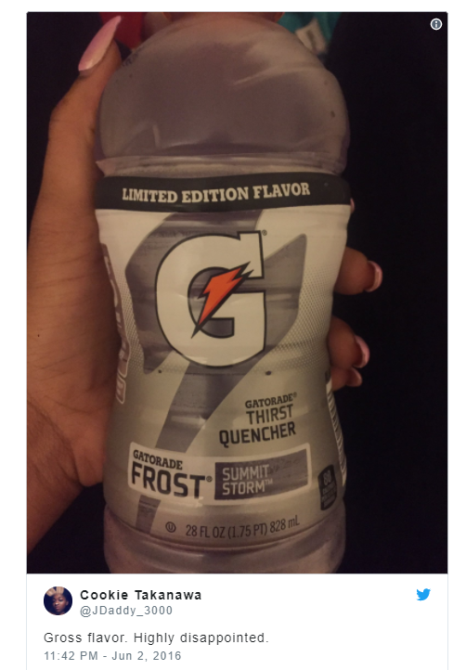
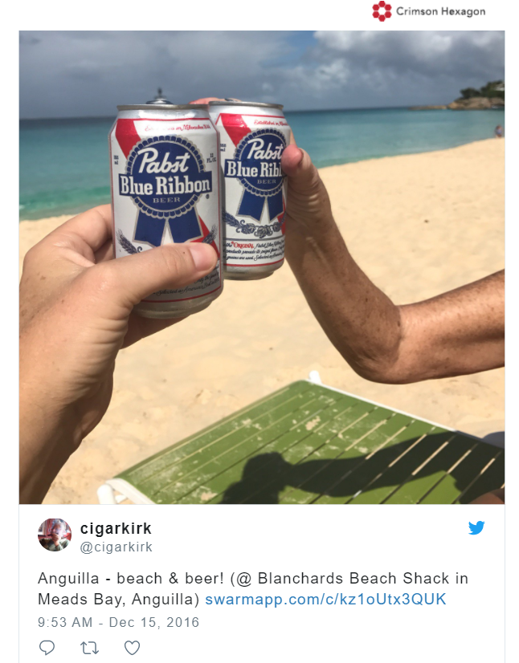
Whole > Sum of Parts?

Slide 26
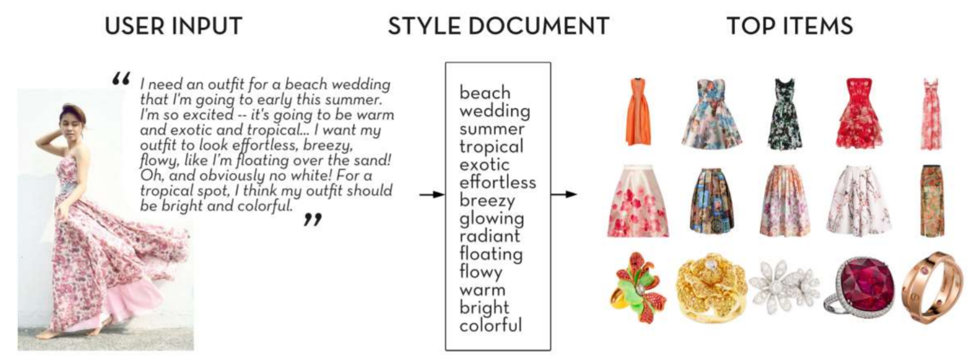
Recommender Systems from Text & Images
Perform image analytics
Calculate similarity with custom embeddings or BERT
Obtain user preferences
Vectorize
Additional information, including tags
Recommendations
Source K. Yamaguchi, 2017

Slide 27
Topic Modeling: A Quick Glance
Very different from clustering documents
What are the topics in these documents?
“I like to eat broccoli and bananas.”
“I ate a banana and spinach smoothie for breakfast.”
“Chinchillas and kittens are cute.”
“My sister adopted a kitten yesterday.”
“Look at this cute hamster munching on a piece of broccoli.”
Latent Dirichlet Allocation (LDA): a way of automatically discovering topics that these sentences contain
Topics and their distributions are “latent”
Source: E. Chen

Slide 28
The Key Ideas
Topics and words
Topic A: 30% broccoli, 15% bananas, 10% breakfast, 10% munching, …
Topic B: 20% chinchillas, 20% kittens, 20% cute, 15% hamster, …
Documents and topics
Documents 1 and 2: 100% Topic A
Documents 3 and 4: 100% Topic B
Document 5: 60% Topic A, 40% Topic B
Source: E. Chen

Slide 29
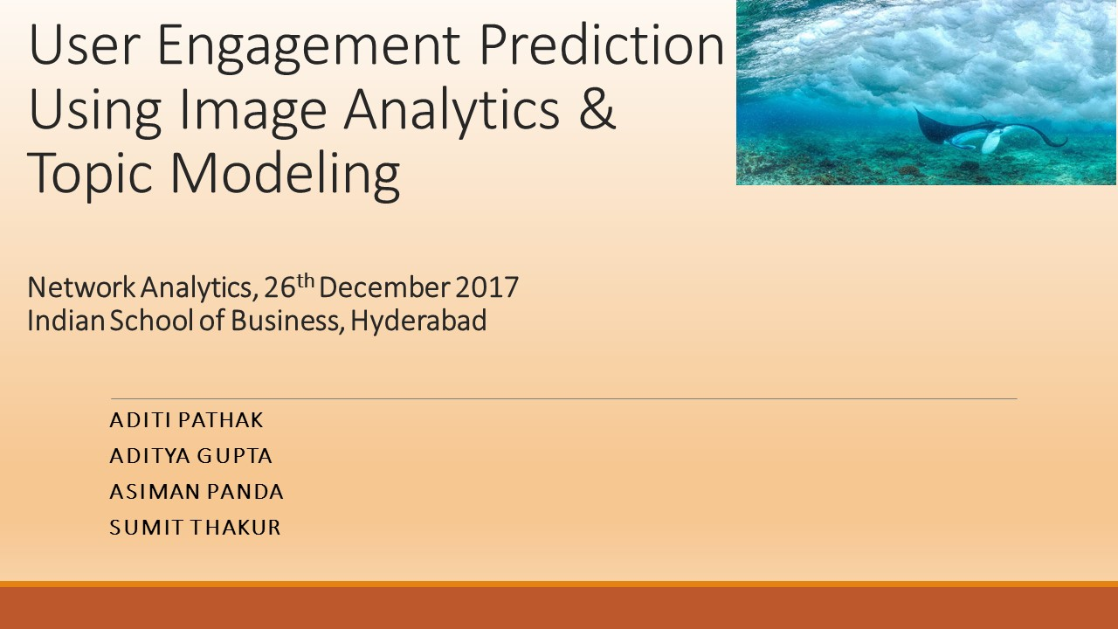
Exemplar Project 2

Slide 30
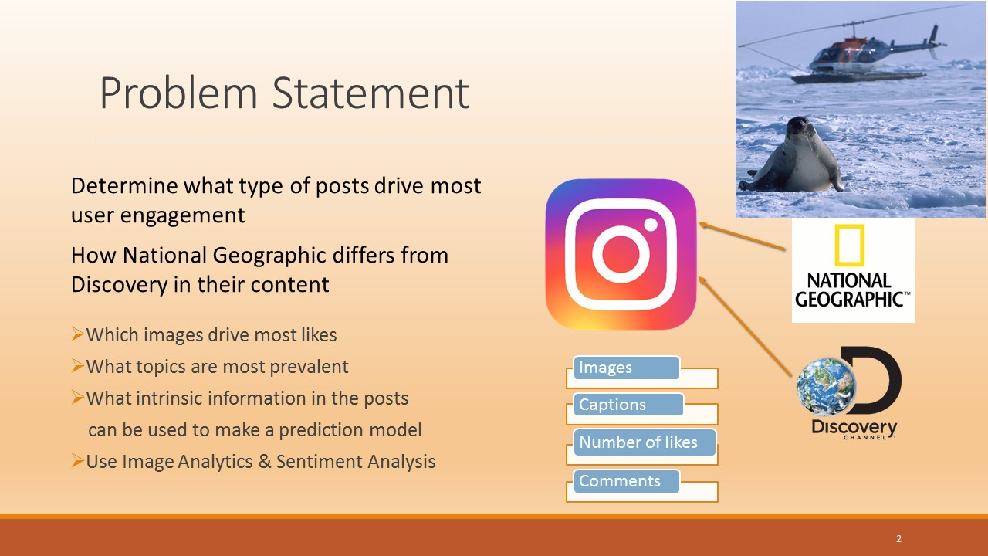

Slide 31
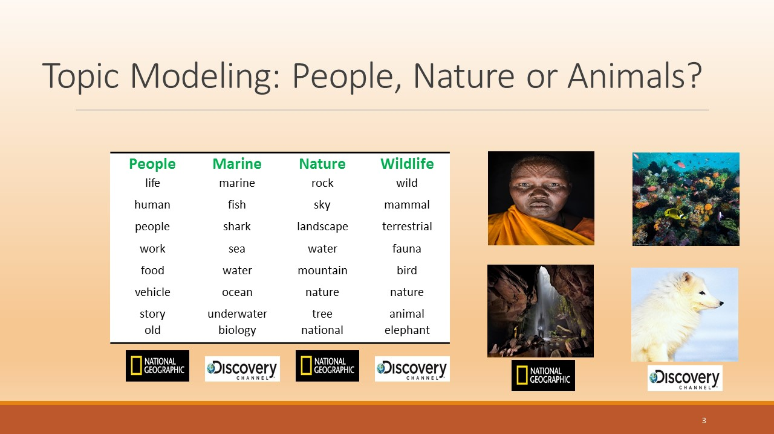

Slide 32
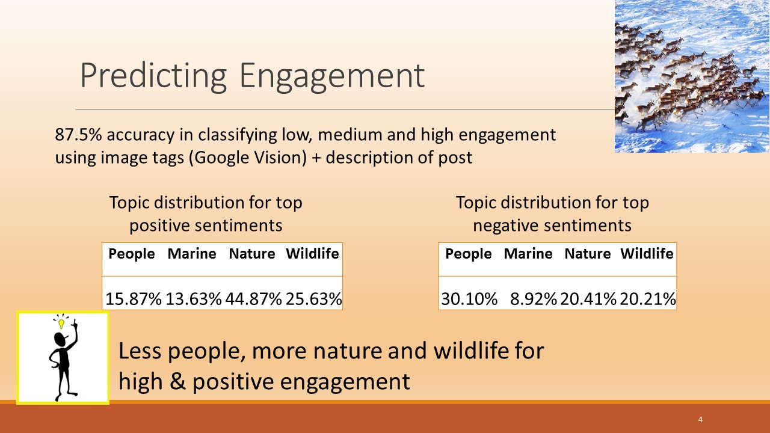

Slide 33
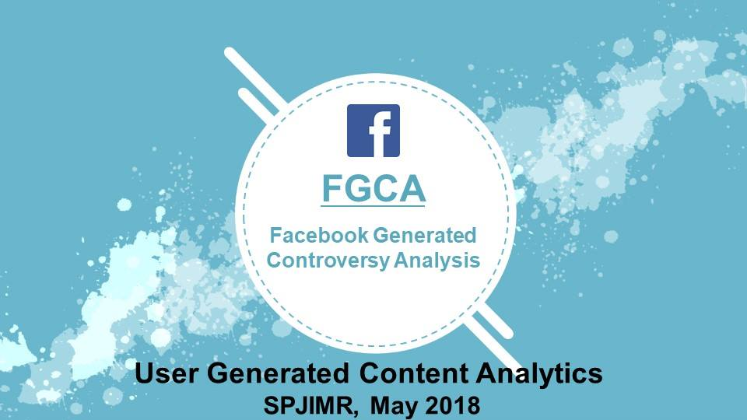
Exemplar Project 3

Slide 34
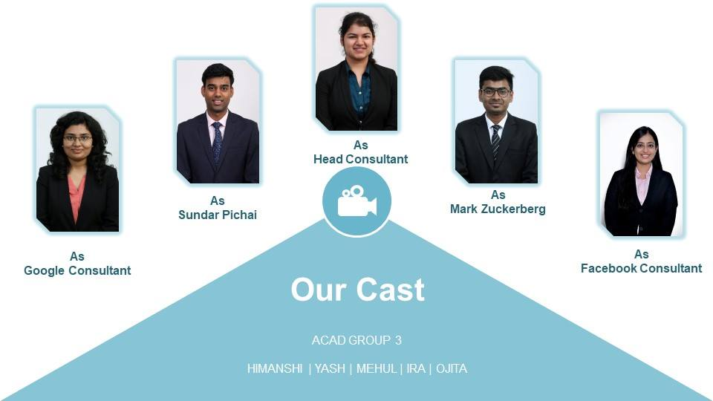
Familiar Faces?

Slide 35
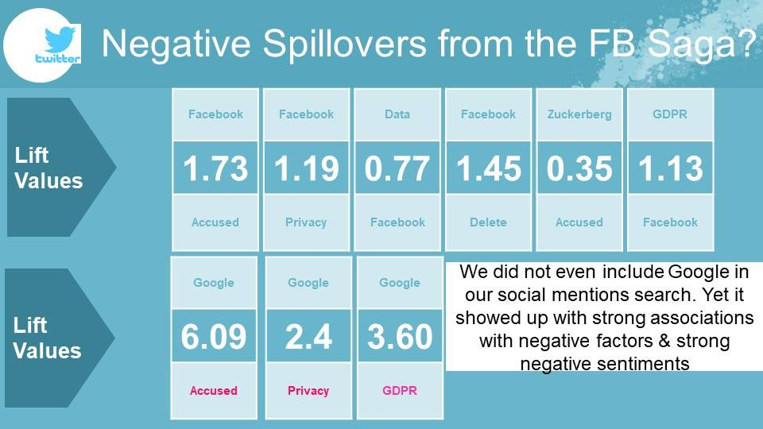
Simple, But Powerful Message

Slide 36
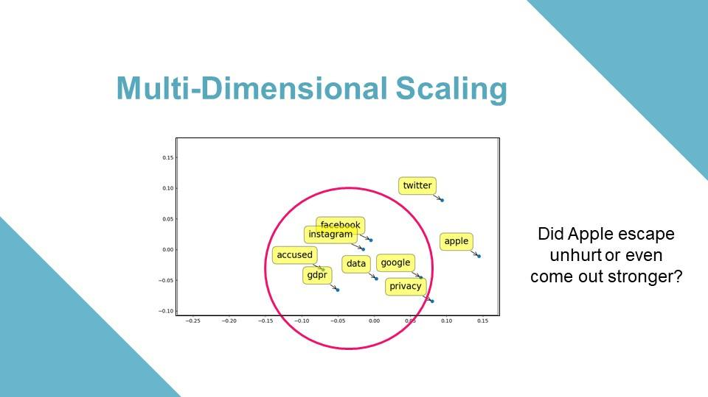
The Aha Moment(s)

